Slide 1

CHAT BOT
CHAT BOT FOR GCE USING artificial intelligence

Slide 2
Team members
Jegaa Selvan J (20104031)
Stanish T (20104056)
Gokul KRISHNA V (20104026)
GUIDED BY
Subhashree kalidass B.E
Assistant professor,cse
HICET,COIMBATORE

Slide 3
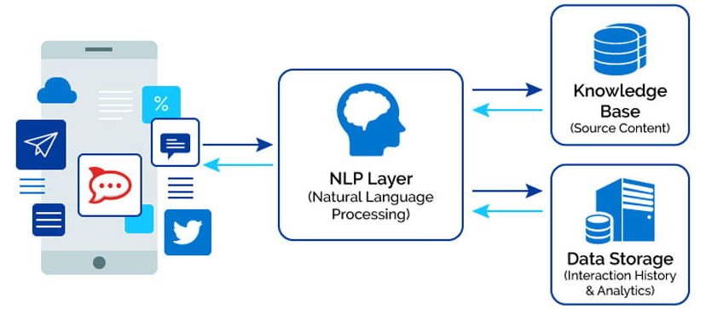
ABSTRACT:
It more focus on designing a textual communication application namely chatbot for our college website. The proposed chatbot assists in answering questions provided by the users.
The Chatbot software can understand the discussion it is having with the user and respond accordingly.

Slide 4
INTRODUCTION
A chatbot can be defined as an AI based computer program that simulates human conversations. They are also known as digital assistants that understand human capabilities. Bots interpret the user intent, process their requests, and give prompt relevant answers. Once the analysis is done appropriate response is delivered to the user. Chatbots work by adopting three classification methods.
Pattern matching Natural language understanding (NLU) Natural language processing (NLP)

Slide 5
PROBLEM STATEMENT
If a certain person has a question that he needs to enquire, he/she would need to visit varied departments gathering segments of the solution to the question he had. As we see, whenever admission days are nearer all college members strive their best to guide parents and students to induce into course they want. Our Chatbot will reduce half the work by giving students brief information concerning admission, courses, fees and lots of additional. All the queries by students will be answered through the chatbot.

Slide 6
OBJECTIVES:
The main objective of "Chatbot" is to minimize the time required to solve the queries of an user , reduce the work load on the college’s office staff , save the time and strength of an user of visiting and contacting the administration office often , keep the user fully updated about the ongoing and upcoming events of college , etc.

Slide 7
LITERATURE SURVEY
AUTHOR(S) | YEAR | TITLE OF PAPER | RESEARCH METHODOLOGY
Yinyin Liu and Xiaolong Wang | 2020 | "A survey on chatbot design techniques in speech conversation systems" | design techniques for chatbots in speech conversation systems, including natural language processing (NLP), dialogue management, and user modeling.
Hua Wei and Qi Yu | 2019 | "A Review of Chatbot Technologies Using Natural Language Processing" | This paper provides an overview of different chatbot technologies, including rule-based systems, retrieval-based models, and generative models.

Slide 8
EXISTING SYSTEM:
Lack of Understanding:
Chatbot’s may fail to understand user queries due to limitations in their natural language processing algorithms.
Lack of Contextual Understanding:
For example, if a user asks "What is the weather like today?" and the chatbot responds with "I don't know what you mean", it indicates that the chatbot
is unable to comprehend the context of the user query.
Inability to Handle Complex Queries:
Chatbots may struggle to handle complex queries that require multiple steps or pieces of information.
Lack of Emotion and Empathy:
For example, a user may express frustration with a chatbot, and the chatbot may respond with a neutral or irrelevant message, which can further aggravate the user.

Slide 9
PROPOSED SYSTEM:
Implement natural language processing (NLP):NLP is a crucial component of a chatbot , as it enables the chatbot to understand user input and generate appropriate responses. Implement NLP technology such as machine learning algorithms to train the chatbot.
By using advanced NLP algorithms, such as deep learning models, the proposed chatbot system can better understand user queries and generate more accurate responses.
Ensuring that the chatbot responds quickly to user queries can improve user satisfaction and engagement. This can be achieved through optimization of the chatbot's algorithms and infrastructure.
Continuous learning and improvement in chatbots can be achieved through a process called machine learning.

Slide 10
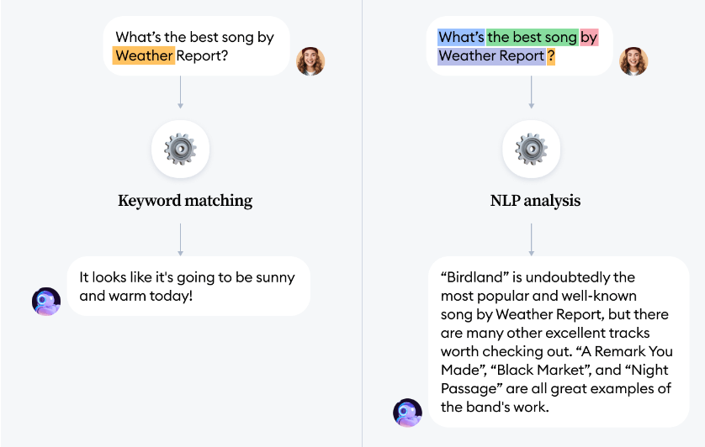
NLP FOR CHATBOT
NLP is an applied artificial intelligence (AI) program that helps your chatbot analyze and understand the natural human language communicated with your customers.
With NLP, your chatbot will be able to streamline more tailored, unique responses, interpret and answer new questions or commands, and improve the customer’s experience according to their needs.
NLP combines computational linguistics that is the rule-based modelling of the human spoken language with intelligent algorithms such as statistical, machine, and deep learning algorithms.

Slide 11
User Input
Conversation
Query
Conversation/Query
Removing Stop Words
Stemming
Reply with simple sentences that have been Hardcoded.
Spellcheck
Matching the words with the tags in the database
Display/Replay Result
Reframing the matching contents into sensible replies

Slide 12
FACTORS DETERMINING EFFICIENCY:
Response Accuracy :
(number of correctly answered queries/tot no of queries)/100
2. Response Time:
It is calculated in ms/step.
Steps could include tasks like tokenizing user input, running natural language processing algorithms, generating a response.
3. Error Rate :
(Number of errors / Total number of queries) * 100

Slide 13
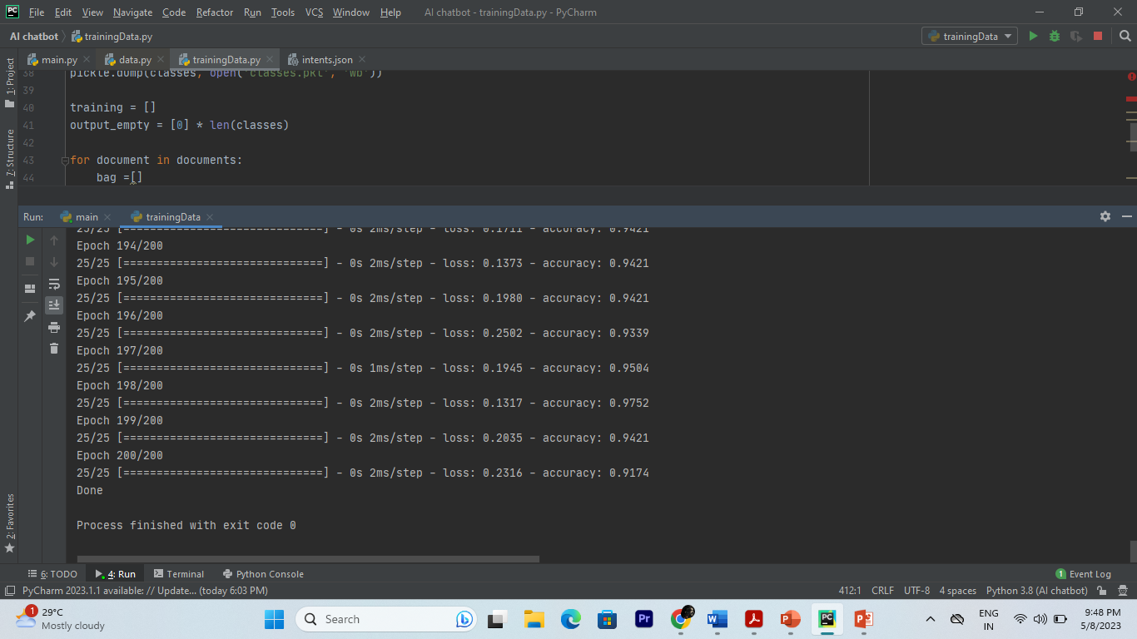
TraininG the data:

Slide 14
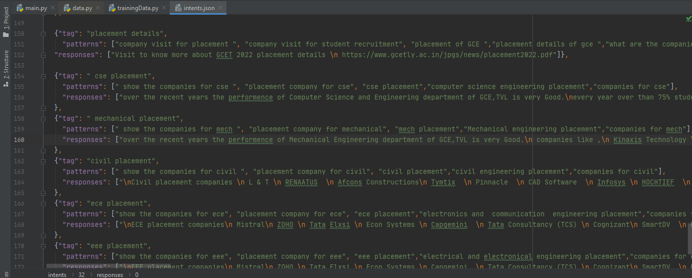
Data in Json Format:

Slide 15
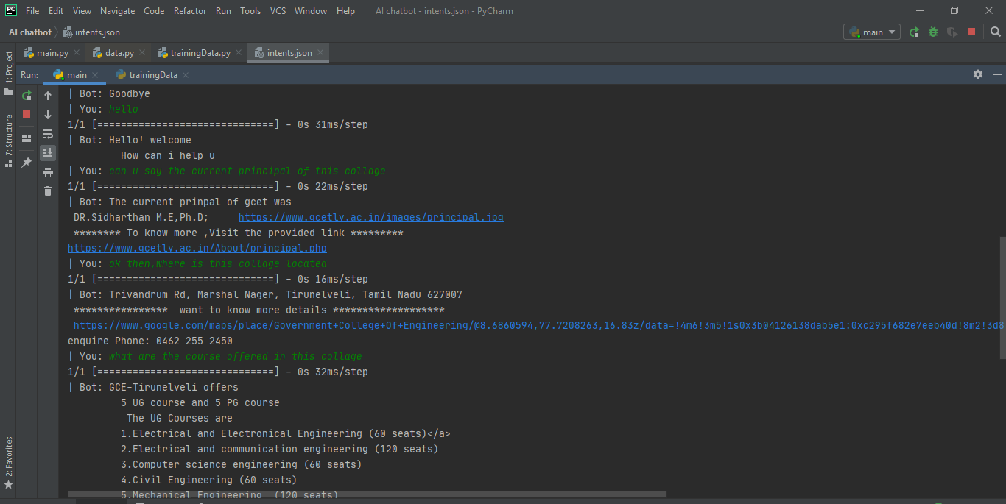
Chat with bot

Slide 16
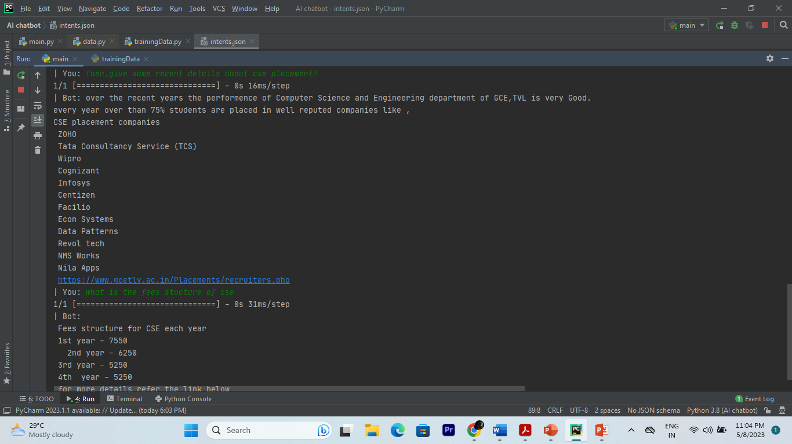

Slide 17
CONCLUSION:
Thus the chat bot using AI for gce ,Tirunelveli has been implemented to make conversation/quering about the college details .
This will definitely help the gce,Tirunelveli students to get needed more information about the college

Slide 18
Thank you

